Slide 1
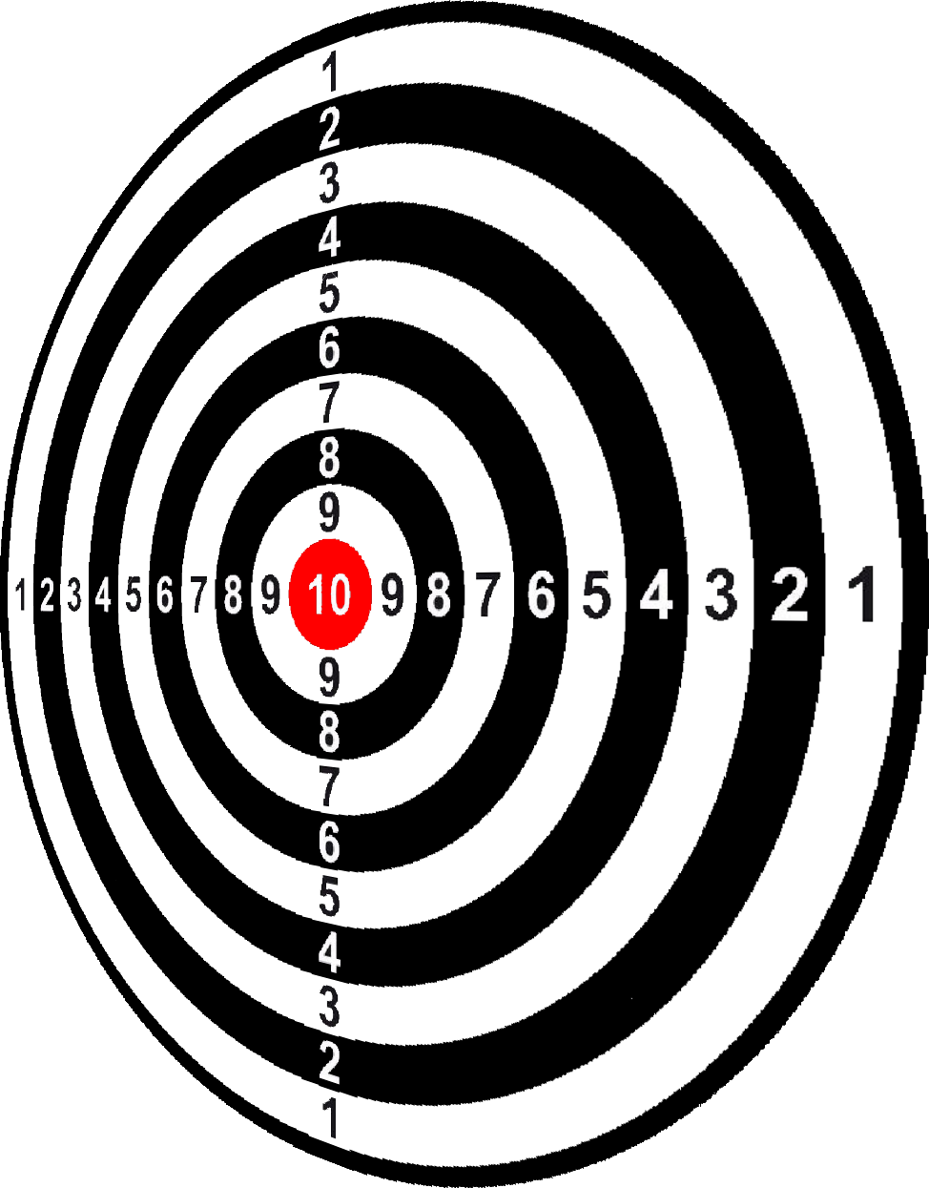
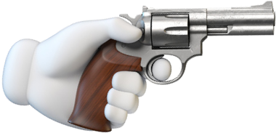
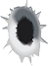
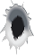
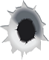
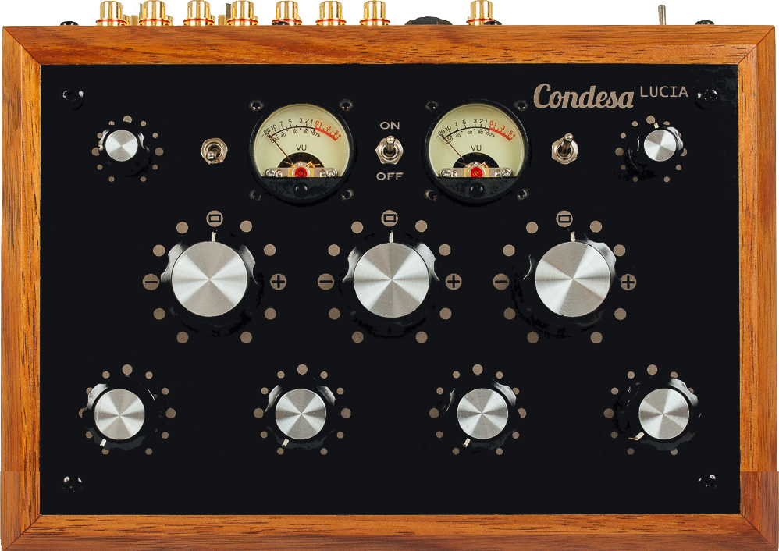
Learn Through Trial and Error
Make a trial to get an intermediate result
Evaluate the discrepancy (error) between the result and the target
Adjust the dials (weights) accordingly to “make” next shot closer to the target.
Go back to the 1st step.

Slide 2
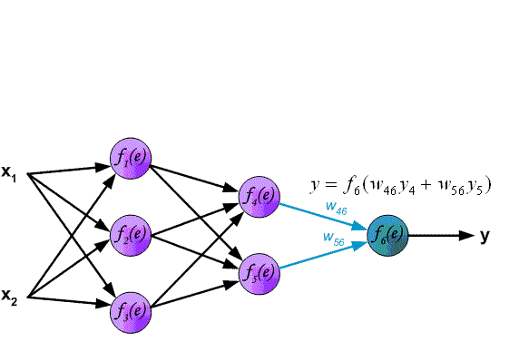
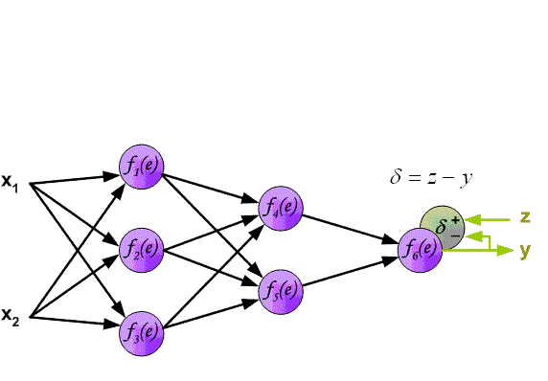
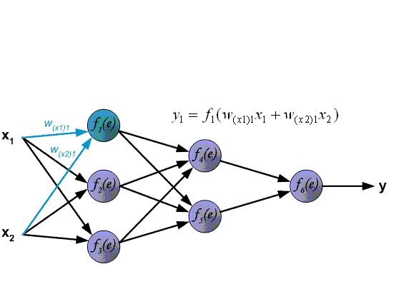
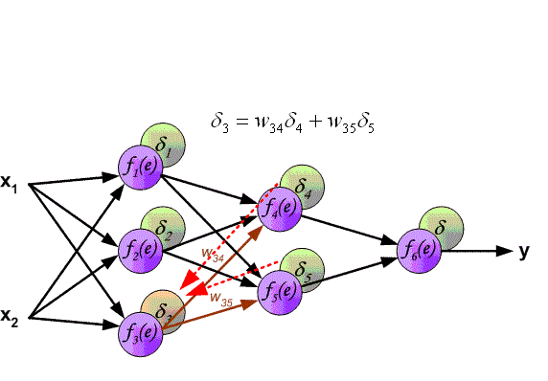
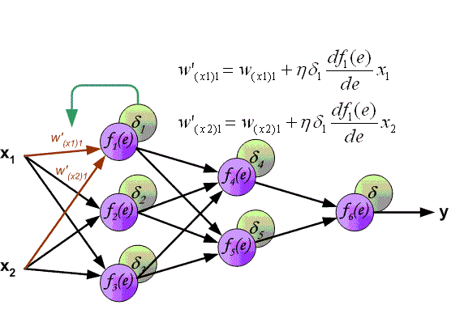
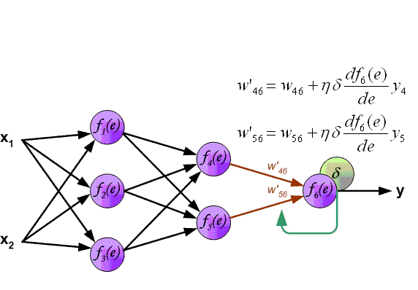
1. Forward Propagation
1. Make A Trial
2. Backward Propagation
2. Evaluate Errors
3. Gradient Descent
3. Adjust Weights
4. Neural Network Training
4. Go Back to the 1st

Slide 3
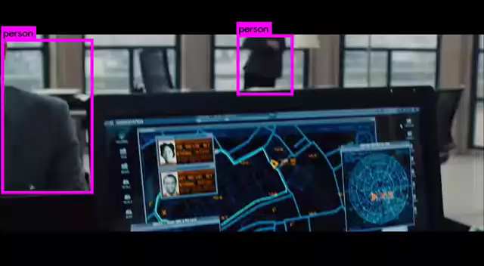
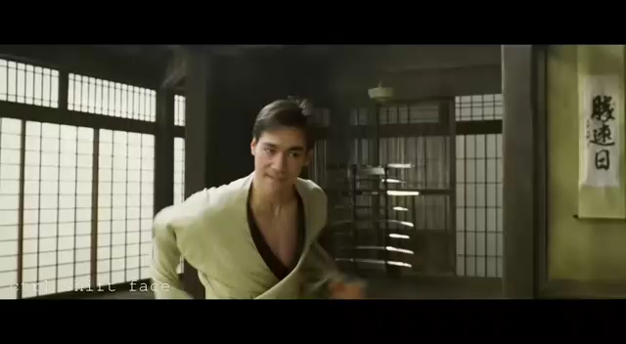
1. Forward Propagation
2. Backward Propagation
3. Stochastic Gradient Descent
4. Neural Network Training

Slide 4




